Slide 1
LAN Extension into a WAN
Establishing a WAN Connection with Frame Relay

Slide 2
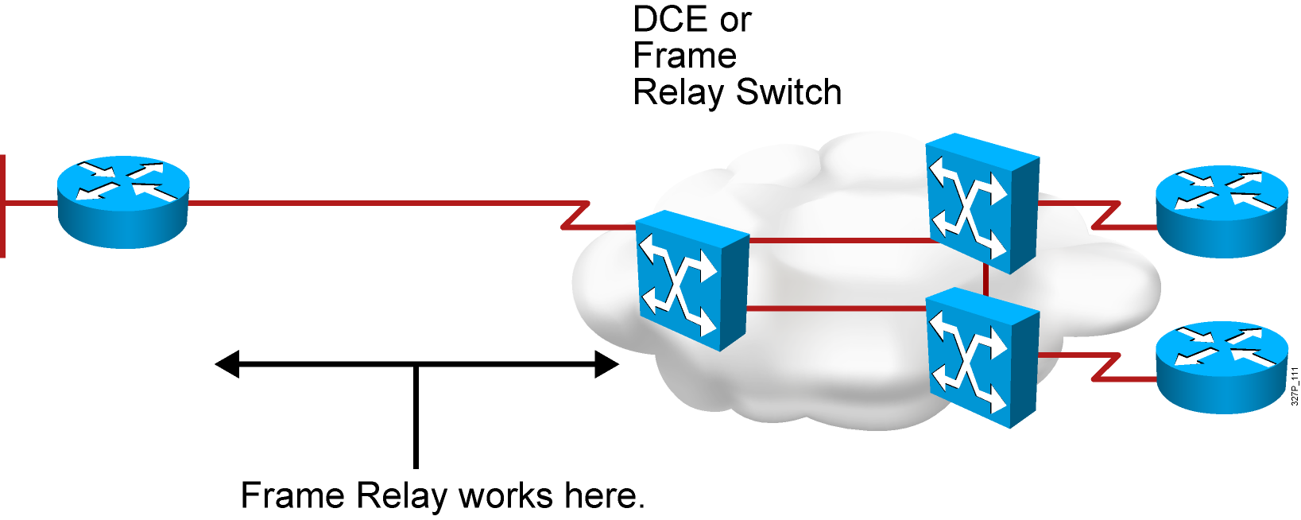
Frame Relay Overview
Connections made by virtual circuits
Connection-oriented service
Notes:
Purpose: This figure provides a big-picture definition of Frame Relay.
Emphasize: Frame Relay is used between the CPE device and the Frame Relay switch. It does NOT affect how packets get routed within the Frame Relay cloud.
Frame Relay is a purely Layer 2 protocol.
The network providing the Frame Relay service can be either a carrier-provided public network or a network of privately owned equipment serving a single enterprise.
Make a clear distinction between DCE, DTE, and CPE.
Emphasize that Frame Relay over SVCs is not discussed in this chapter because it is not widely supported by service providers at this time. The service provider must also support SVCs in order for Frame Relay over SVCs to operate.
Note: In Cisco IOS Release 11.2, two traffic shaping features were introduced:
Generic (adaptive) traffic shaping
Frame Relay traffic shaping
Both of these features can be used to adjust the rate at which traffic is sent by the router. In addition, these features allow the router to throttle the traffic rate based on BECNs received from the Frame Relay switch. Neither of these features are discussed in this course. Frame Relay traffic shaping is discussed in the Building Cisco Remote Access Networks (BCRAN) course. Information on both can be found in Cisco documentation.

Slide 3
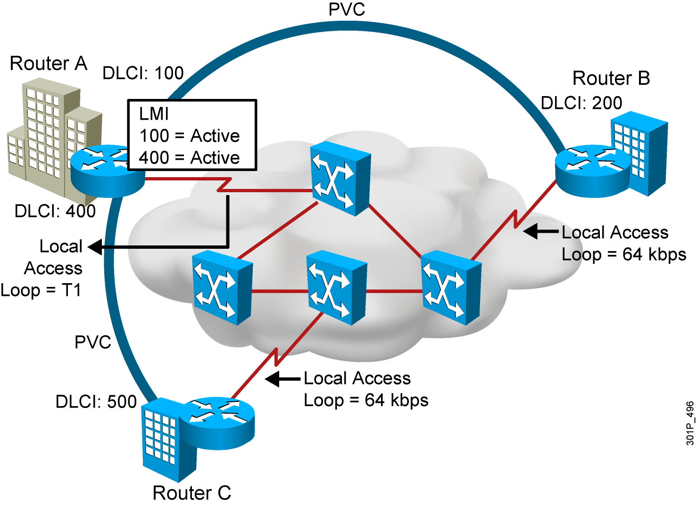
Frame Relay Terminology
Notes:
Purpose: This figure provides an overview of terminology so that the student is prepared to understand the Frame Relay operation discussion.
The terminology used with Frame Relay varies by service provider. These are the commonly used terms.
Point out the local access loop and note that the local access rate is different than the rate used within the Frame Relay cloud.
The DLCI is of local significance, therefore, point out that the same DLCI can be used in multiple places in the network.
The autosensing LMI is a Release 11.2 or later feature.
Frame Relay connections are made using PVCs. The circuits are identified by the DLCI assigned by the service provider.
Reference: For more information on Frame Relay, including a Frame Relay glossary, refer to the Frame Relay Forum World Wide Web page:
http://www.frforum.com/4000/4003.html
This course does not discuss Frame Relay traffic flow issues. Terms like BECN, FECN, and discard eligible are not discussed in this course. These terms are some of the terms that can be found in the Frame Relay Forum’s glossary. The BCRAN discusses Frame Relay traffic flow issues.

Slide 4
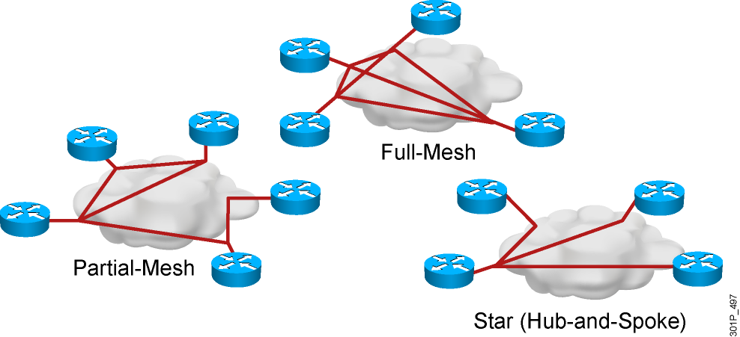
Selecting a Frame Relay Topology
Frame Relay default: NBMA
Notes:
Purpose: This figure is a transition discussion to illustrate the need for subinterfaces. Now that students are familiar with the concept and configuring of Frame Relay, they are ready to consider the issues and solutions related to broadcast updates in an NBMA Frame Relay network.
Emphasize: Compare the different topologies described.
Explain that by default, interfaces that support Frame Relay are multipoint connection types. This type of connection is not a problem when only one PVC is supported by a single interface; but it is a problem when multiple PVCs are supported by a single interface. In this situation, broadcast routing updates received by the central router cannot be broadcast to the other remote sites.
Broadcast routing updates are issued by distance vector protocols. Link-state and hybrid protocols use multicast and unicast addresses.

Slide 5
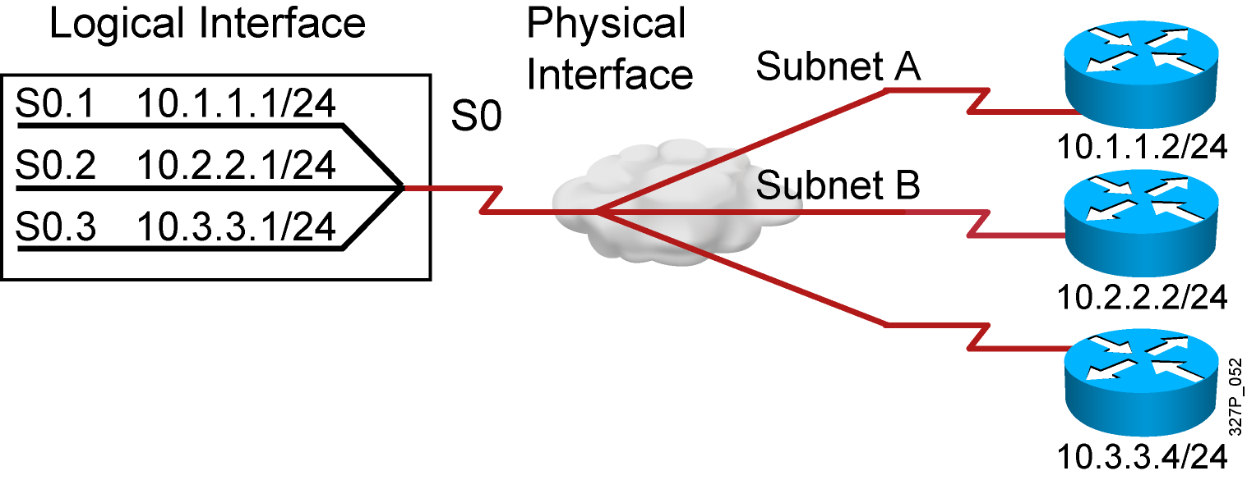
Resolving NBMA Reachability Issues
Split horizon can cause problems in NBMA environments.
  Solution: subinterfaces
  A single physical interface simulates multiple logical interfaces.
Notes:
Purpose: This figure defines subinterfaces and how they can resolve NBMA issues.
Emphasize: You can have connectivity problems in a Frame Relay network if the following conditions exist:
You are using an NBMA model.
Your configuration is in a partial mesh.
You are using a distance vector routing protocol.
Split-horizon is enabled on the routing protocol.
If the routing protocol is configured with split-horizon, routing updates from one router connected on the multipoint subinterface are not propagated to other routers connected on this multipoint subinterface. For example, if router C sends a routing update, this split horizon will keep this update from being sent back out the subinterface to router D.
To resolve this problem you can do the following:
Use Frame Relay subinterfaces to overcome the split-horizon problem.
Use a routing protocol that supports disabling split-horizon.
Use this configuration if you want to save IP address space.
You can also use this type of configuration with several fully meshed groups. Routing updates will be exchanged between the fully meshed routers.
Note: When an interface is assigned “encapsulation frame-relay,” split horizon is disabled for IP and enabled for IPX and AppleTalk, by default.

Slide 6
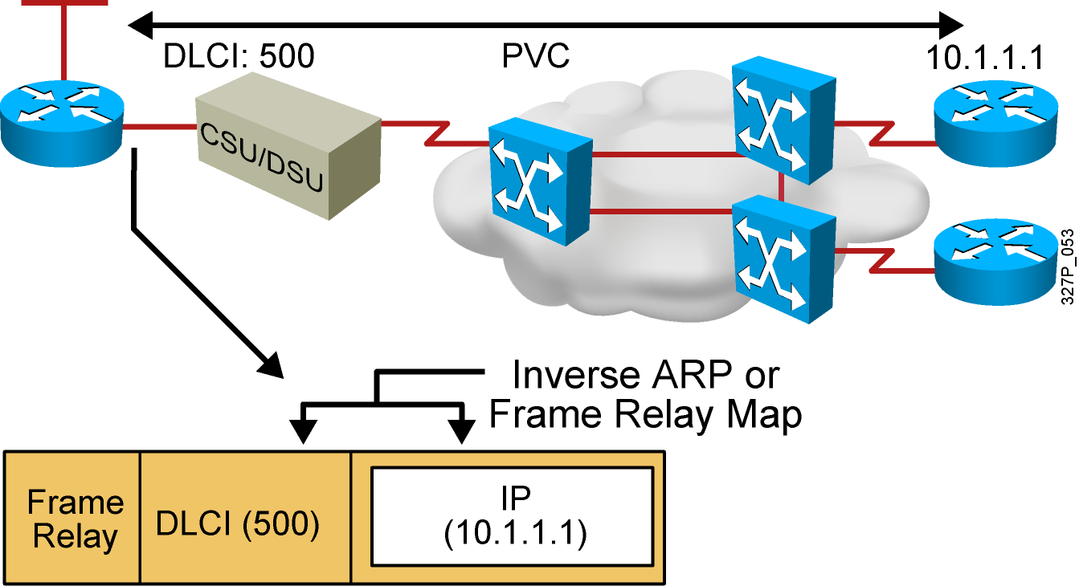
Frame Relay Address Mapping
LMI receives locally significant DLCI from the Frame Relay switch.
Inverse ARP maps the local DLCI to the remote router network
layer address.
Notes:
Purpose: This figure illustrates mapping the data-link connection identifier (DLCI) to the network-layer address such as IP.
Emphasize: The DLCI is of local significance, therefore, point out that the same DLCI can be used in multiple places in the network. Frame Relay connections are made using PVCs. The circuits are identified by the DLCI assigned by the service provider.
Explain what Inverse ARP is used for. Static mapping can be configured instead of Inverse ARP.

Slide 7
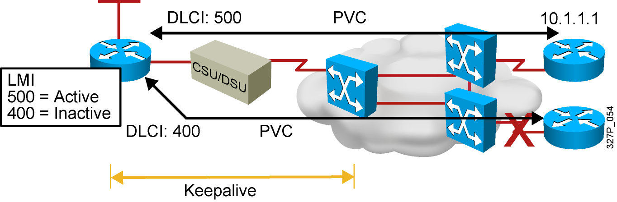
Frame Relay Signaling
Cisco supports three LMI standards:
  Cisco
  ANSI T1.617 Annex D
  ITU-T Q.933 Annex A
Notes:
Purpose: This figure describes the Local Management Interface (LMI) and shows the key standards.
Emphasize: Explain LMI.
Note: Other key American National Standards Institute (ANSI) standards are T1.606, which defines the Frame Relay architecture, and T1.618, which describes data transfer.
Other key International Telecommunication Union Telecommunication Standardization Sector (ITU-T) specifications include I.122, which defines ITU-T Frame Relay architecture, and Q.922, which standardizes data transfer. Use of these LMI standards is especially widespread in Europe.
The original “gang of four” no longer exists; StrataCom® merged with Cisco, and Digital Equipment Corporation was acquired by Compaq Computers.

Slide 8
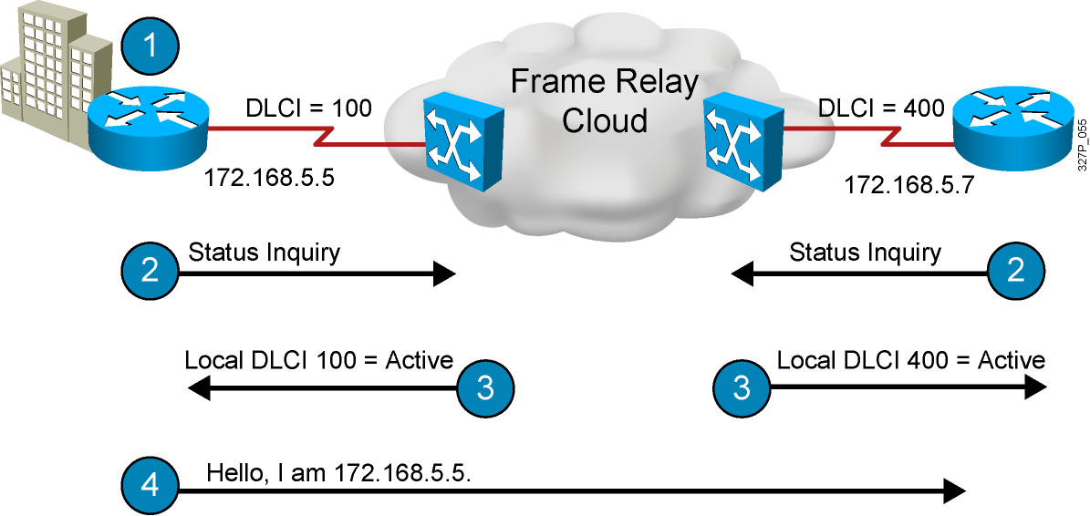
Stages of Inverse ARP and LMI Operation
Notes:
Layer 4 of 4
Purpose: This figure describes the Inverse ARP and LMI process.
Emphasize: Step 1—Indicates that each router must connect to the Frame Relay switch.
Step 2—Discusses what information is sent from the router to the Frame Relay switch.
Step 3—Discusses what the Frame Relay switch does with the received information.
Step 4—Discusses the sending of Inverse ARP messages.

Slide 9
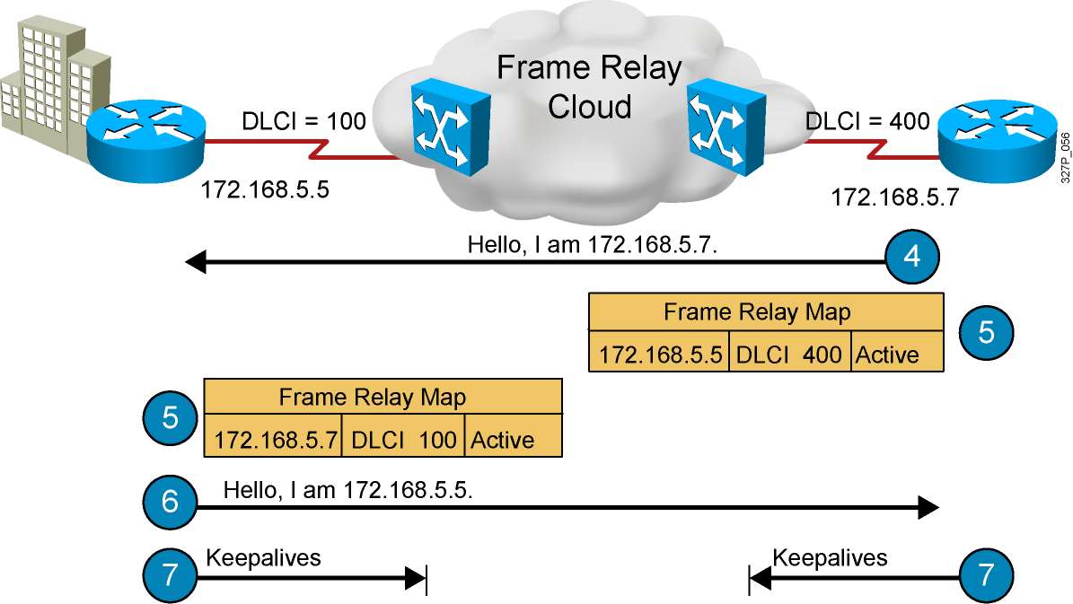
Stages of Inverse ARP and LMI Operation (Cont.)
Notes:
Layer 3 of 3
Purpose: This figure describes the Inverse ARP and LMI process.
Emphasize: Step 5—Discusses how the Inverse ARP message is used to create the Frame Relay map table dynamically.
Step 6—Shows how Inverse ARP has a periodic interval.
Step 7—Discusses the periodic interval for keepalive messages. It’s an LMI function.
Transition: The next section explains how to configure Frame Relay.

Slide 10
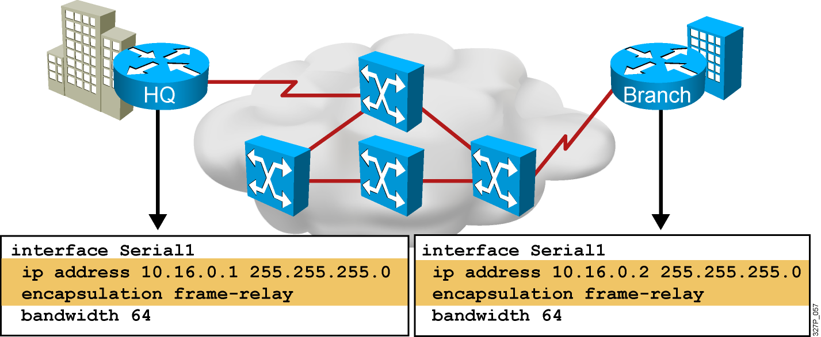
Configuring Basic Frame Relay
Notes:
Slide 1 of 2:
Purpose: This figure introduces basic Frame Relay configuration over a physical interface. It is important that students understand how configuration occurs in order for them to understand the subinterfaces discussion later in the chapter.
These steps assume that LMI and Inverse ARP are supported, therefore no static maps are needed.
Regarding Step 3:
Cisco’s Frame Relay encapsulation uses a 4-byte header, with 2 bytes to identify the DLCI and 2 bytes to identify the packet type.
Use the ietf encapsulation command to connect to other vendors. The IETF standard is defined in RFCs 1294 and 1490.
Regarding Step 4:
The LMI connection is established by the frame-relay lmi-type [ansi | cisco | q933a] command. The default values established during initial setup are usually sufficient to maintain connectivity with the Frame Relay network. Altering these values would only be required in case of intermittent failures. Changing the default values of the LMI should only be attempted after consulting with your service provider.
These configuration steps are the same, regardless of the network-layer protocols operating across the network.

Slide 11
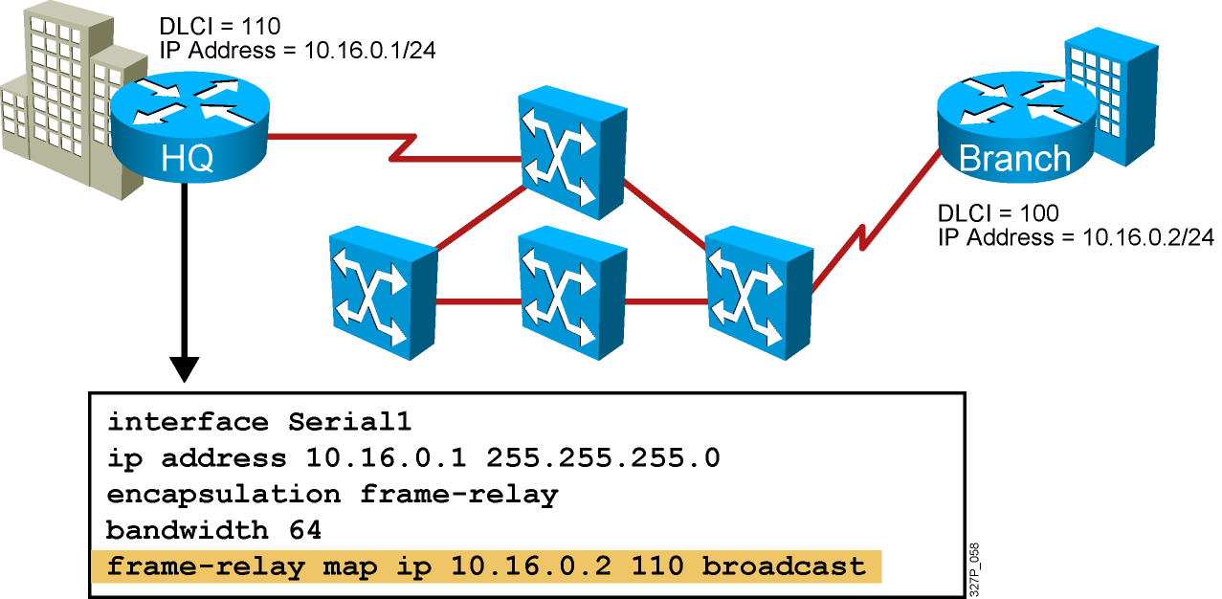
Configuring a Static Frame Relay Map
Configure a static Frame Relay map when:
  A Frame Relay peer does not support Inverse ARP
  You want to control broadcast traffic across a PVC
  You want to have different Frame Relay encapsulations across PVCs
Notes:
Purpose: This figure discusses the static map command option:
Emphasize: You can use the frame-relay map command to configure multiple DLCIs to be multiplexed over one physical link. Instead of using Inverse ARP, the Frame Relay map tells the Cisco IOS software how to get from a specific protocol and address pair to the correct DLCI.
Point out that this command is similar to building a static route.
The simplest way to generate a static map is to let the router learn the information dynamically first. Some users let the router learn the information dynamically, then enable static maps for easier network administration.
These configuration steps are the same, regardless of the network-layer protocols operating across the network.
Although static maps are not needed when Inverse ARP is enabled, it is a good idea to configure them for each connection for easier network administration.

Slide 12
Configuring Frame Relay Subinterfaces
  Point-to-point
    Subinterfaces act like leased lines.
    Each point-to-point subinterface requires its own subnet.
    Point-to-point is applicable to hub-and-spoke topologies.
  Multipoint
    Subinterfaces act like NBMA networks, so they do not resolve the split-horizon issues.
    Multipoint can save address space because it uses a single subnet.
    Multipoint is applicable to partial-mesh and full-mesh topologies.
Notes:
Purpose: This figure begins the discussion on configuring subinterfaces.
Emphasize: The encapsulation frame-relay command is assigned to the physical interface. All other configuration items, such as the network-layer address and DLCIs, are assigned to the subinterface.
Multipoint may not save you addresses if you are using VLSMs. Further, it may not work properly given the broadcast traffic and split-horizon considerations. The point-to-point subinterface option was created to avoid these issues.
Note: Subinterfaces are also used with ATM networks and IPX LAN environments where multiple encapsulations exist on the same medium.

Slide 13
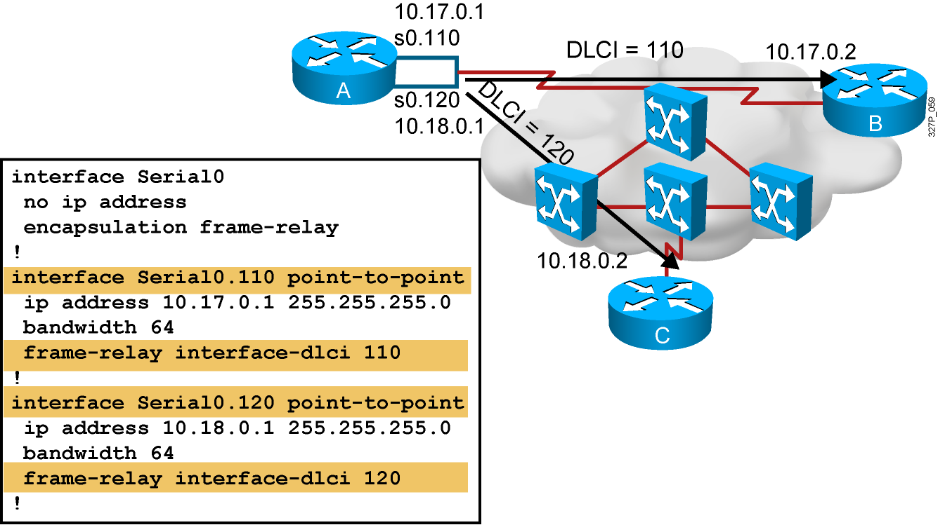
Configuring Frame Relay Point-to-Point Subinterfaces
Notes:
Purpose: This figure continues the discussion of configuring subinterfaces.
Emphasize: The Frame Relay service provider will assign the DLCI numbers. These numbers range from 16 to 992. This range will vary depending on the LMI used.
Use the frame-relay interface-dlci command on subinterfaces only. Use of the command on an interface, rather than a subinterface, will prevent the device from forwarding packets intended for the DLCI. It is also required for multipoint subinterfaces for which dynamic address resolution is enabled. It is not used for multipoint subinterfaces configured with the frame-relay map command for static address mapping.
Using the frame-relay interface-dlci command with subinterfaces provides greater flexibility when configuring Frame Relay networks.
On multipoint subinterfaces, the frame-relay interface-dlci command enables Inverse ARP on the subinterface. When this command is used with point-to-point subinterfaces, all traffic for the subinterface’s subnetwork are sent out this subinterface.
The ability to change a subinterface from point-to-point to multipoint, or vice versa, is limited by the software architecture. The router must be rebooted for a change of this type to take effect. An alternative exists to rebooting the router and creating a network outage. Create another subinterface in the software and migrate the configuration parameters to the new subinterface using the proper point-to-point or multipoint setting, as required.

Slide 14
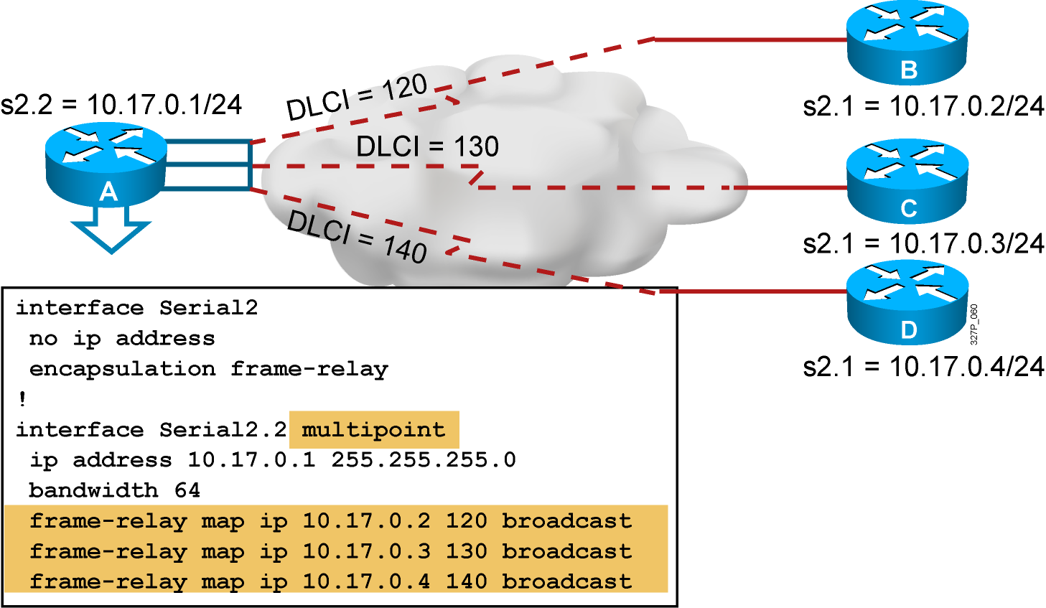
Configuring Frame Relay Multipoint Subinterfaces
Notes:
Purpose: This graphic illustrates a multipoint subinterface example.
Emphasize: In this example, the subinterface is configured to behave as a normal NBMA Frame Relay interface.
No IP address is configured on the physical interface. It is important that the physical interface NOT have an address, otherwise routing will not work.
The frame-relay map command is used to create the multiple PVC connections from a single interface.
All connections are in the same subnet.
The DLCIs are provided by your service provider.

Slide 15
Verifying Frame Relay Operation
RouterX# show interfaces type number
Displays information about Frame Relay DLCIs and the LMI
RouterX# show interfaces s0
Serial0 is up, line protocol is up
Hardware is HD64570
Internet address is 10.140.1.2/24
MTU 1500 bytes, BW 1544 Kbit, DLY 20000 usec, rely 255/255, load 1/255
Encapsulation FRAME-RELAY, loopback not set, keepalive set (10 sec)
LMI enq sent 19, LMI stat recvd 20, LMI upd recvd 0, DTE LMI up
LMI enq recvd 0, LMI stat sent 0, LMI upd sent 0
LMI DLCI 1023 LMI type is CISCO frame relay DTE
FR SVC disabled, LAPF state down
Broadcast queue 0/64, broadcasts sent/dropped 8/0, interface broadcasts 5
Last input 00:00:02, output 00:00:02, output hang never
Last clearing of "show interface" counters never
Queueing strategy: fifo
Output queue 0/40, 0 drops; input queue 0/75, 0 drops
<Output omitted>
Notes:
Slide 1 of 6
Purpose: This figure shows how the show interface command is used to verify whether Frame Relay operation and router connectivity to remote routers are working.
Emphasize: Describe the highlighted output to the students.

Slide 16
Verifying Frame Relay Operation (Cont.)
RouterX# show frame-relay lmi [type number]
Displays LMI statistics
RouterX# show frame-relay lmi
LMI Statistics for interface Serial0 (Frame Relay DTE) LMI TYPE = CISCO
Invalid Unnumbered info 0 Invalid Prot Disc 0
Invalid dummy Call Ref 0 Invalid Msg Type 0
Invalid Status Message 0 Invalid Lock Shift 0
Invalid Information ID 0 Invalid Report IE Len 0
Invalid Report Request 0 Invalid Keep IE Len 0
Num Status Enq. Sent 113100 Num Status msgs Rcvd 113100
Num Update Status Rcvd 0 Num Status Timeouts 0
Notes:
Slide 2 of 6
Purpose: This figure shows how the show frame-relay LMI command is used to verify the LMI type used for signaling.
Emphasize: Describe the highlighted output to the students.

Slide 17
Verifying Frame Relay Operation (Cont.)
RouterX# debug frame-relay lmi
Frame Relay LMI debugging is on
Displaying all Frame Relay LMI data
RouterX#
1w2d: Serial0(out): StEnq, myseq 140, yourseen 139, DTE up
1w2d: datagramstart = 0xE008EC, datagramsize = 13
1w2d: FR encap = 0xFCF10309
1w2d: 00 75 01 01 01 03 02 8C 8B
1w2d:
1w2d: Serial0(in): Status, myseq 140
1w2d: RT IE 1, length 1, type 1
1w2d: KA IE 3, length 2, yourseq 140, myseq 140
1w2d: Serial0(out): StEnq, myseq 141, yourseen 140, DTE up
1w2d: datagramstart = 0xE008EC, datagramsize = 13
1w2d: FR encap = 0xFCF10309
1w2d: 00 75 01 01 01 03 02 8D 8C
1w2d:
1w2d: Serial0(in): Status, myseq 142
1w2d: RT IE 1, length 1, type 0
1w2d: KA IE 3, length 2, yourseq 142, myseq 142
1w2d: PVC IE 0x7 , length 0x6 , dlci 100, status 0x2 , bw 0
Displays LMI debug information

Slide 18
Verifying Frame Relay Operation (Cont.)
RouterX# show frame-relay pvc [type number [dlci]]
Displays PVC statistics
RouterX# show frame-relay pvc 100
PVC Statistics for interface Serial0 (Frame Relay DTE)
DLCI = 100, DLCI USAGE = LOCAL, PVC STATUS = ACTIVE, INTERFACE = Serial0
input pkts 28 output pkts 10 in bytes 8398
out bytes 1198 dropped pkts 0 in FECN pkts 0
in BECN pkts 0 out FECN pkts 0 out BECN pkts 0
in DE pkts 0 out DE pkts 0
out bcast pkts 10 out bcast bytes 1198
pvc create time 00:03:46, last time pvc status changed 00:03:47
Notes:
Slide 3 of 6
Purpose: This figure shows how the show frame-relay pvc command is used to verify whether Frame Relay operation and router connectivity to remote routers are working.
Emphasize: Describe the highlighted output to the students.

Slide 19
Verifying Frame Relay Operation (Cont.)
RouterX# show frame-relay map
Displays the current Frame Relay map entries
RouterX# clear frame-relay-inarp
Clears dynamically created Frame Relay maps, created by using Inverse ARP
RouterX# show frame-relay map
Serial0 (up): ip 10.140.1.1 dlci 100(0x64,0x1840), dynamic,
broadcast,, status defined, active
RouterX# clear frame-relay-inarp
RouterX# show frame map
RouterX#
Notes:
Slide 4 of 6
Purpose: This figure shows how the show frame-relay map command is used to verify that Frame Relay has a map entry in the Frame Relay map table.
Emphasize: Describe the highlighted output to the students.

Slide 20
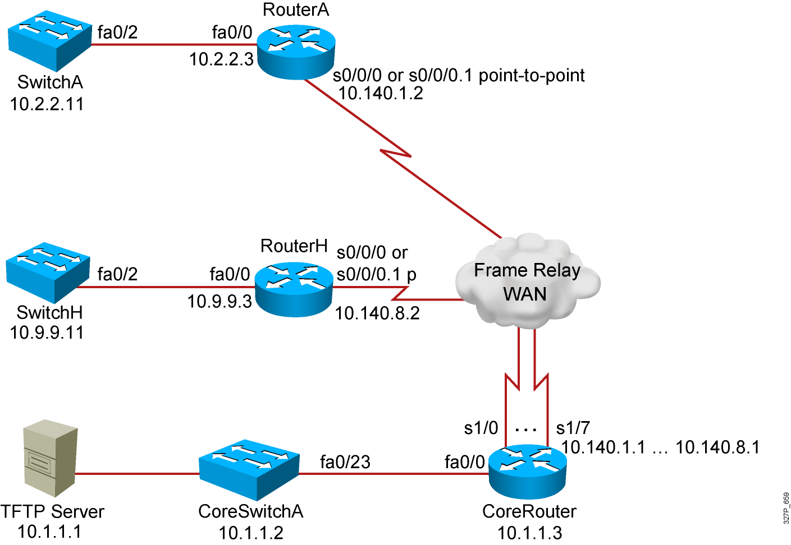
Visual Objective 8-1:
Establishing a Frame Relay WAN
WG Router s0/0/0
A 10.140.1.2
B 10.140.2.2
C 10.140.3.2
D 10.140.4.2
E 10.140.5.2
F 10.140.6.2
G 10.140.7.2
H 10.140.8.2
Notes:
Lab 16 Frame Relay
Objectives: Enable the Frame Relay on a serial link.
Purpose: Teach students how to enable Frame Relay.
Laboratory Instructions: Refer to the lab setup guide.

Slide 21
Summary
  Frame Relay PVCs are identified with DLCIs, and the status of the PVCs are reported via the LMI protocol.
  Frame Relay point-to-point subinterfaces require a separate subnet for each PVC, and multipoint subinterfaces share a single subnet with frame relay peers.
  To display connectivity with the Frame Relay provider, use the show frame-relay lmi command. To display connectivity with the Frame Relay peer, use the show frame-relay pvc and show frame-relay map commands.

